Slide 1
Iot based prediction of water quality index for farm irrigation
Created by:
Rajesh Kumar Yadav
Adarsh jha
Aditya Choudhary

Slide 2
Introduction(TEMP)
Less Productivity in Agriculture Sectors( 50 % workforce contributes 16% to the GDP).
Growing needs due to ever growing population
Lab tests are expensive, time consuming and generally not feasible for farmers.
IoT sensors can be used to measure gather data in bulk which can be analyzed using various AI techniques for increased productivity and quality.

Slide 3
Introduction
Less Productivity in Agriculture Sectors( 50 % workforce contributes 16% to the GDP). There exists a need to increase the efficiency of each stage in farming and at a cheap cost so that it is affordable. With improvement in technology, these needs can be addressed using innovative solutions like the Internet of Things(IoT).
Salinity of water used in irrigation can affect soil nutrients and plant growth as described in the works of Mark[1] and Shrivastav[2]. Based on this, Meireles developed an Irrigation Water Quality Index(IWQI)[3].
In this paper we focus on determining irrigation water quality by developing a classification model for prediction of IWQI class based on IWQI developed by Meireles.
[1] M. E. Grismer and K. M. Bali, “Drought tip: Use of saline drain water for crop production,” 2015
[2] P. Shrivastava and R. Kumar, “Soil salinity: a serious environmental issue and plant growth promoting bacteria as one of the tools for its alleviation,” Saudi journal of biological sciences, vol. 22, no. 2, pp. 123–131, 2015.
[3] A. C. M. Meireles, E. M. d. Andrade, L. C. G. Chaves, H. Frischkorn, and L. A. Crisostomo, “A new proposal of the classification of irrigation water,” Revista Ciencia Agronomica, vol. 41, no. 3, pp. 349–357, 2010

Slide 4
Objectives
We convert 5 parameters: Na⁺, Cl⁻, EC, HCO³⁻ and SAR to quality measurement values which are used to calculate IWQI. We construct IWQI classes using IWQI values for irrigation water.
We reduce 5 parameters to 3 parameters using correlation analysis to save costs of sensors required to implement the proposed work. These parameters are used to classify IWQI using seven classification techniques which are Support Vector Classifier, Neural Networks, Gradient Boosting , Random Forest, Decision Tree, Bagging and Naive Bayes classifier.
We evaluate and choose the best performing classification algorithm to obtain IWQI class for water sample with 3 parameters.

Slide 5
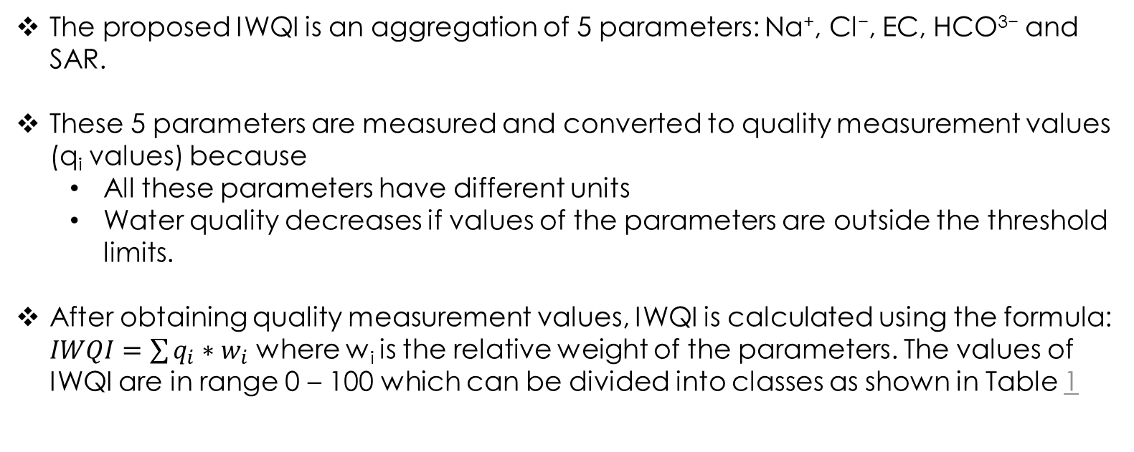
Irrigation water quality index
The proposed IWQI is an aggregation of 5 parameters: Na⁺, Cl⁻, EC, HCO³⁻ and SAR.
These 5 parameters are measured and converted to quality measurement values (q_{i} values) because
All these parameters have different units
Water quality decreases if values of the parameters are outside the threshold limits.
After obtaining quality measurement values, IWQI is calculated using the formula: $IWQI=\sum{q_{i}∗w_{i}}$ where w_{i} is the relative weight of the parameters. The values of IWQI are in range 0 – 100 which can be divided into classes as shown in Table 1

Slide 6
Table 1: Range for IWQI classes
IWQI | Soil | Plant
85–100 | Can be used for any kind of soil | Most plants won’t be affected
70–85 | Can be used on soil with moderate permeability | Avoid use in plants with very low salt tolerance
55–70 | Can be used on soils with moderate to high permeability | Avoid in plants with low salt tolerance
40–55 | Can be used on soils with high permeability without dense layers | Used mainly in plants with high salt tolerance. Plants with moderate salt tolerance can be used with some control practices
0–40 | Use for irrigation should be avoided | Avoid for all plants

Slide 7
Dataset: Major Ions Dataset
Table 2: IWQI parameters
Name of parameter | Unit
Sodium ion | mmol/L
Calcium ion | mmol/L
Magnesium ion | mmol/L
Chloride ion | mmol/L
Electrical conductivity | dS/cm
Bicarbonate ion | mmol/L
The dataset used in our work was obtained from US Geological Survey of Brackish Groundwater [4]. We select the parameters required to calculate IWQI which are mentioned in Table 2 along with their units.
Sodium, Magnesium and Calcium ions concentrations are used to calculate SAR.
[4] S. Qi and A. Harris, “Geochemical database for the brackish groundwater assessment of the united states,” US Geological Survey data release, 2017.

Slide 8
Developing the classification model
We calculate IWQI using 5 parameters from Major ions dataset and convert them to IWQI classes according to ranges given in Table 1.
We perform correlation analysis on the parameters in IWQI which is given in Table 3. The following observations are made:
Cl⁻ is highly correlated with EC and Na⁺.
Na⁺ is highly correlated with all the parameters.
EC is highly correlated with all the parameters except SAR.
HCO³⁻ is highly correlated with EC.
IWQI is highly correlated with Cl⁻, Na⁺ and EC.
We select 3 parameters: Cl⁻, Na⁺ and EC according to their correlation with IWQI as features for the classification algorithm.

Slide 9
Table 3: Correlation matrix for various parameters for water samples
 | Cl⁻ | Na⁺ | EC | HCO³⁻ | SAR | IWQI
Cl⁻ | 1 | 0.467 | 0.506 | 0.159 | 0.083 | 0.44
Na⁺ | 0.467 | 1 | 0.482 | 0.297 | 0.56 | 0.607
EC | 0.506 | 0.482 | 1 | 0.835 | 0.018 | 0.423
HCO³⁻ | 0.159 | 0.297 | 0.835 | 1 | 0.018 | 0.293
SAR | 0.083 | 0.56 | 0.018 | 0.018 | 1 | 0.302
IWQI | 0.44 | 0.607 | 0.423 | 0.293 | 0.302 | 1
To cover variety of classification methods, 7 classification algorithms are used which are: Support Vector Classifier, Neural Networks, Gradient Boosting , Random Forest, Decision Tree, Bagging and Naive Bayes classifier.

Slide 10
OVERALL ARCHITECTURE

Slide 11
Experimental setup
Table 4: Parameter settings for 7 classifiers
Classifier | Parameter Settings
Bagging Classifier | base_estimator:SVC, n_estimators:10
DecisionTree | criterion: gini, splitter: best, min_samples_split: 2
Naive Bayes | alpha: 1.0, class_prior: None, class_count: [ 7059. 15826. 5057. 2055. 402.]
Gradient Boosting | loss: deviance, learning rate: 0.1, n_estimators: 100
Random Forest | n_estimators: 100, criterion: gini, base_estimator_: DecisionTreeClassifier
SVM | C: 1.0, decision_function_shape: 'ovr', tol:0.001
MLP | hidden_layer_sizes:128, activation='relu', learning_rate=0.001
The algorithm was implemented in Python 3 where data preprocessing is performed using Pandas and Numpy. Various classification algorithms are applied using Scikit-learn. The parameter settings for these algorithms are given in Table 4.

Slide 12
Evaluation metrics
The classification algorithms are evaluated using the following metrics:
Accuracy: It tell us how much data can be predicted accurately from a given classifier. This gives us an idea about the bulk of data which is correctly classified.
Precision: It tells us how many predictions are correct out of all observations saying output belongs to a particular class.
Recall: It tells us how many correct predictions were made for a class out of all the actual observations for a given class.
F1 Score: It can be defined as harmonic mean of precision and recall, can be used independently for evaluation of classifiers.

Slide 13
Results
Table 5: Classification results for 7 classifiers
Methods | Accuracy | Precision | Recall | F1
DecisionTree | 0.832 | 0.728 | 0.740 | 0.733
Naive Bayes | 0.526 | 0.105 | 0.200 | 0.138
Gradient Boosting | 0.858 | 0.762 | 0.757 | 0.760
Random Forest | 0.869 | 0.790 | 0.765 | 0.776
SVM | 0.845 | 0.762 | 0.711 | 0.726
Bagging | 0.813 | 0.750 | 0.664 | 0.690
MLP | 0.846 | 0.734 | 0.743 | 0.738
Random Forest performed the best with an accuracy of 86.9% followed by Gradient Boosting and Neural Networks with accuracy of 85.8% and 84.6% respectively. Naive Bayes classifier performed the worst with accuracy of 52.6%. The classification results and cross validation scores are given in Table 5 and 6 respectively.

Slide 14
Table 6: Cross validation scores for 7 classifiers
Methods | Fold1 | Fold2 | Fold3 | Fold4 | Fold5
Bagging Classifier | 0.829 | 0.823 | 0.814 | 0.830 | 0.813
DecisionTree | 0.833 | 0.836 | 0.828 | 0.823 | 0.839
Naive Bayes | 0.518 | 0.518 | 0.518 | 0.518 | 0.519
Gradient Boosting | 0.862 | 0.866 | 0.869 | 0.859 | 0.862
Random Forest | 0.866 | 0.870 | 0.870 | 0.862 | 0.871
SVM | 0.853 | 0.849 | 0.846 | 0.841 | 0.848
MLP | 0.847 | 0.853 | 0.857 | 0.847 | 0.849

Slide 15
CONCLUSION and Future works
In this work, we developed a classification model for prediction of Irrigation Water Quality Index (IWQI) class.
For classification, we used seven classification algorithms and selected three out of five parameters: EC, Cl− and Na+ for predicting IWQI class. Random Forest Classifier performed the best followed by Gradient Boosting and Neural Networks.
Other parameters such as acidity, oxygen demand etc. can be used in addition to the parameters used here to develop an index covering more factors. Also, dataset covering different types of water bodies can be used to improve the model.
The proposed work used here can be incorporated into IoT based agricultural systems for analysing irrigation water quality that will be faster and economically feasible compared to manual lab tests. It can also help in deciding the water sample according to crop and soil properties.

Slide 16
Thank you

